Slide 1

Welcome to CN4005: Mental Wealth (IT Pitching).
Dr Fadi Safieddine
Week 1: Welcome to the module!
1

Slide 2
Lecture Content:
Part One:
Module introduction:
Aims
The Learning Outcomes
Importance of this module
Communication / Ethical practices
Weekly subjects
The Assessments
Portfolio Project
Guidance for success
Part two:
Self-evaluation form.
How to design your first CV.

Slide 3

Introduction:
The Module covers:
Communication – report writing, presentation and prototyping techniques
Time management
Setting up your own business
Working with people from diverse backgrounds
Professional development – self evaluation and action planning.
These are the skills you need not just for your chosen profession but for any HE study

Slide 4

Module Aims:
This module aims to develop skills that are necessary for success in academic and professional working environments.
They include – Personal skills, organisational skills and self-confidence and initiative skills.

Slide 5
Learning Outcomes
At the end of this module, students will be able to:
Articulate the nature of work practices, employment patterns and industry requirements and research, identify and plan the required skills and competence acquisition for their proposed career area.
Demonstrate awareness of local and global issues (such as inequalities and sustainability) and identify ways in which their personal approach and actions could have a positive social impact on cultures and the wider society.
Effectively identify and understand the underlying emotions of individuals and groups, enhancing communication efficacy, empathy and influence and demonstrating reflexive and reflective thinking in relation to their own development
Use digital tools to gather, and present information and to evaluate and communicate the outcomes of their learning.
Contribute constructively and creatively to a shared production process generated by an external organisation by applying appropriate modes of professional practice and behaviour
Solve problems within a group context.

Slide 6

Why is this module so important!!
It assumes little knowledge.
Skills learned here will be needed in all the modules you will work on.
Important skill for your work.
Skills you develop will be with you for life.

Slide 7
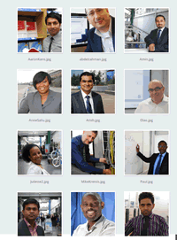
Being professional
Your training starts now.
Career Skills
Communication;
written, demo, presentation
Teamwork
Ethical practices
Mental Wealth
Managing stress
Building confidence
Continuous professional development;
PDP; reflection, evaluation and planning

Slide 8
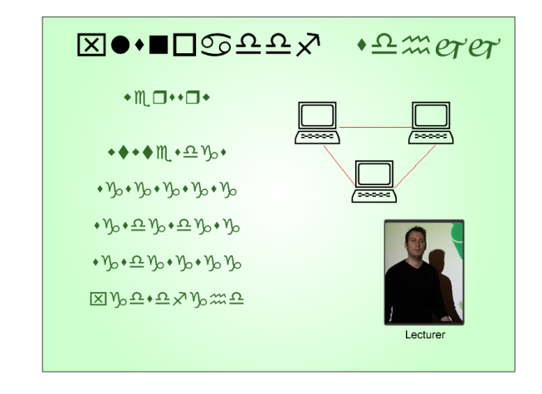

Communication
Through reports, meetings,
e-mail & phone
You will have to communicate to
Define a problem and project objectives
Analyse a problem through literature search
Evaluate material against Objectives
Compile the research to fulfil marking criteria
8

Slide 9

Teamwork
Ethical teamwork
Respect for yourself, team members, clients and users.
Integrity, honest reporting through project monitoring and appraisal systems
Professional standing- if you have respect and integrity you will be trusted.
9

Slide 10
Continuous Professional Development
Requires commitment to
Keep abreast of new technology
Undertake continuous self evaluation and six monthly appraisal
Study, undertake courses
You must be willing to learn from
Experience
Others
Books and journals
10
Notes:
.

Slide 11
End of Part 1
Activity 1.1. Working part of a team, which one of these is key for successful delivery of outcome?

Slide 12
In the next 12 weeks you will learn:
Part 2

Slide 13

In the next 12 weeks you will learn:
Part 2
1. Module Welcoming, and Self-assessment session.
2. IT Technologies: Innovation in Business I
3. IT Technologies: Innovation in Business II and brainstorming Ideas
4. Time Management.
5. IT project management and managing groups
6. Presentation skills I: How not to present.
13

Slide 14
In the next 12 weeks you will learn:
7. Presentation skills II: How to present.
8. Designing and Prototyping
9. Documentation and formatting of reports
10. Setting up your own company: IT consultancy and micro-business
11. Mental Health and Wellbeing.
12. Reflection and Self-evaluation.
14

Slide 15
Assessment
This module will be assessed totally by coursework. UEL assessment regulations required you to achieve a 40% to pass this module.
You should aim for much higher.
15

Slide 16

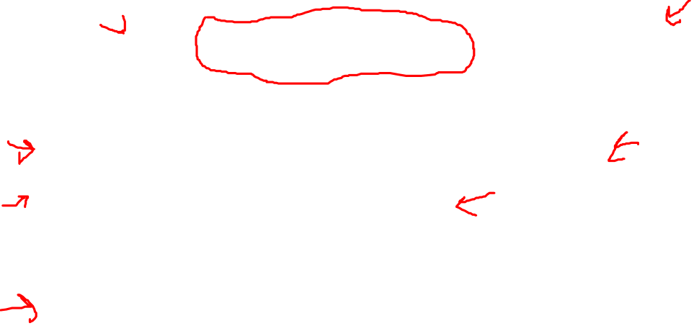
Assessment
1. Portfolio 100%:
Made up of six tasks:
Initial Self-assessment & CV (Individual)
Individual Time Management Plan (Individual)
Proposal for Pitch idea (Group)
Presentation (Group)
Innovation Report (Group)
Final self-evaluation, CV, and reflection on Mental Health.(Individual)

Slide 17


Submission
All submissions for this Module must be submitted to Turnitin.
Detailed guidance on how to submit your work to Turnitin can be found on this Module’s UEL Moodle site.
If you fail to submit the Report you will be awarded a mark of 0% for the component

Slide 18


Guidelines to succeed in this module!
Read ahead:
Review handbook.
Review essential readings – Don’t leave it for last two weeks.
Watch the lectures every week.
Participate in the lecture activities.
Take advantage of the Formative Feedback opportunities.
Write down any questions.
Feel free to ask!
Ask your lab tutor first!!
Email me at fadi@uel.ac.uk

Slide 19

Guidelines to succeed in this module!
Be fair to this module in time investment! Give it at least 4 hours reading a week.
Deadlines:
The deadlines are shown in the handbook.
Work as early as possible.
Make use of the formative feedback in the labs.
Give enough time to review it (at least 48hours)!
Make sure you meet the DEADLINE to get the most of your grade!
Be creative.

Slide 20
End of Part 2:
Activity 1.2. Identify the best practices to getting the highest grade on this module.

Slide 21
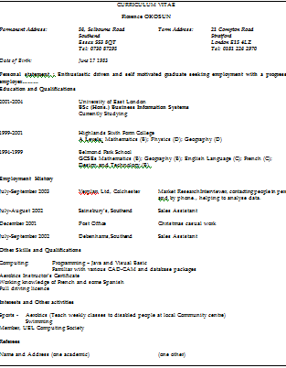
This week’s lesson:
Part 3
Self evaluation and CV writing:
What is self evaluation?
What is a CV?
What is included in a CV?
How to write a great CV.

Slide 22
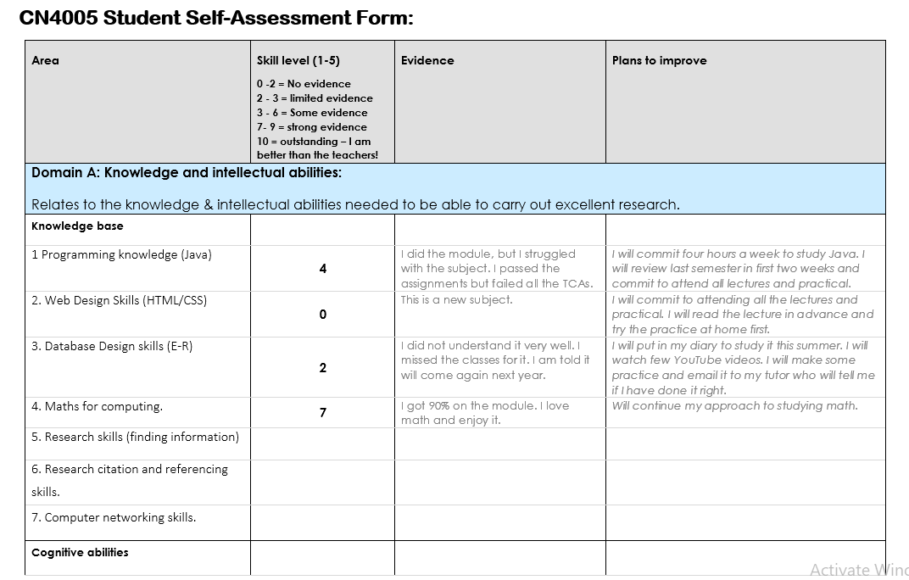
Self Evaluation Form

Slide 23


Slide 24
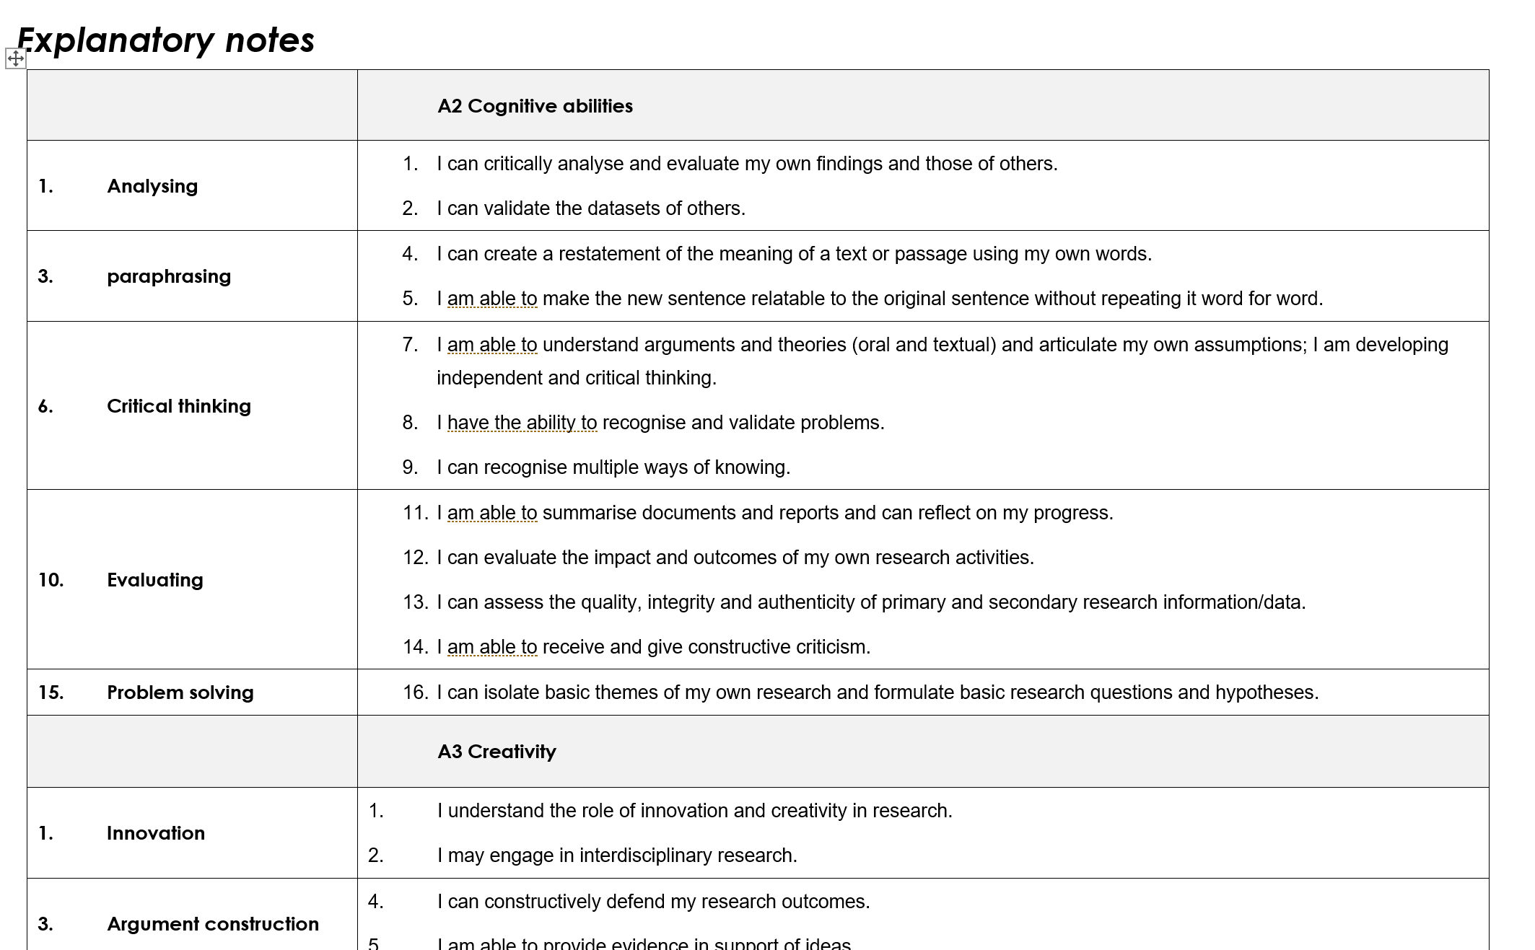

Slide 25
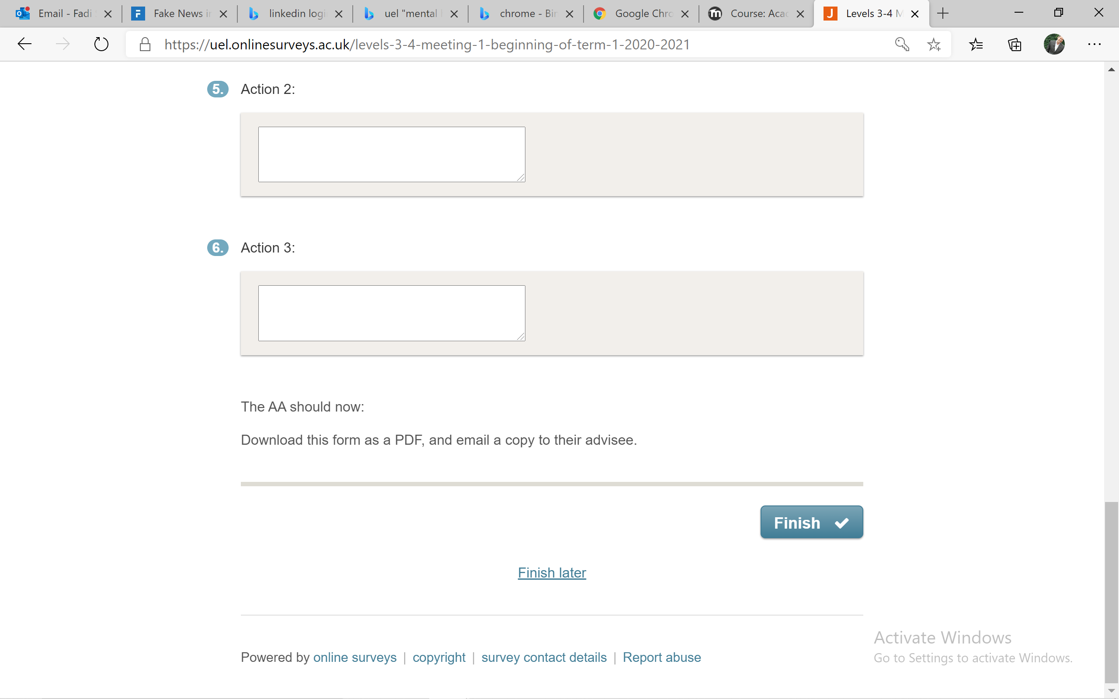
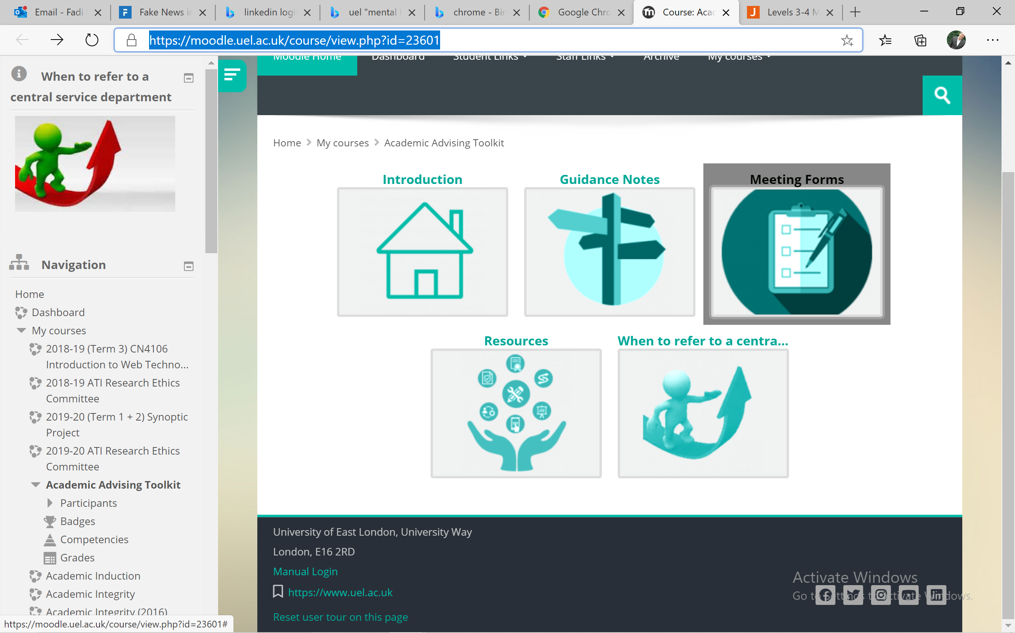
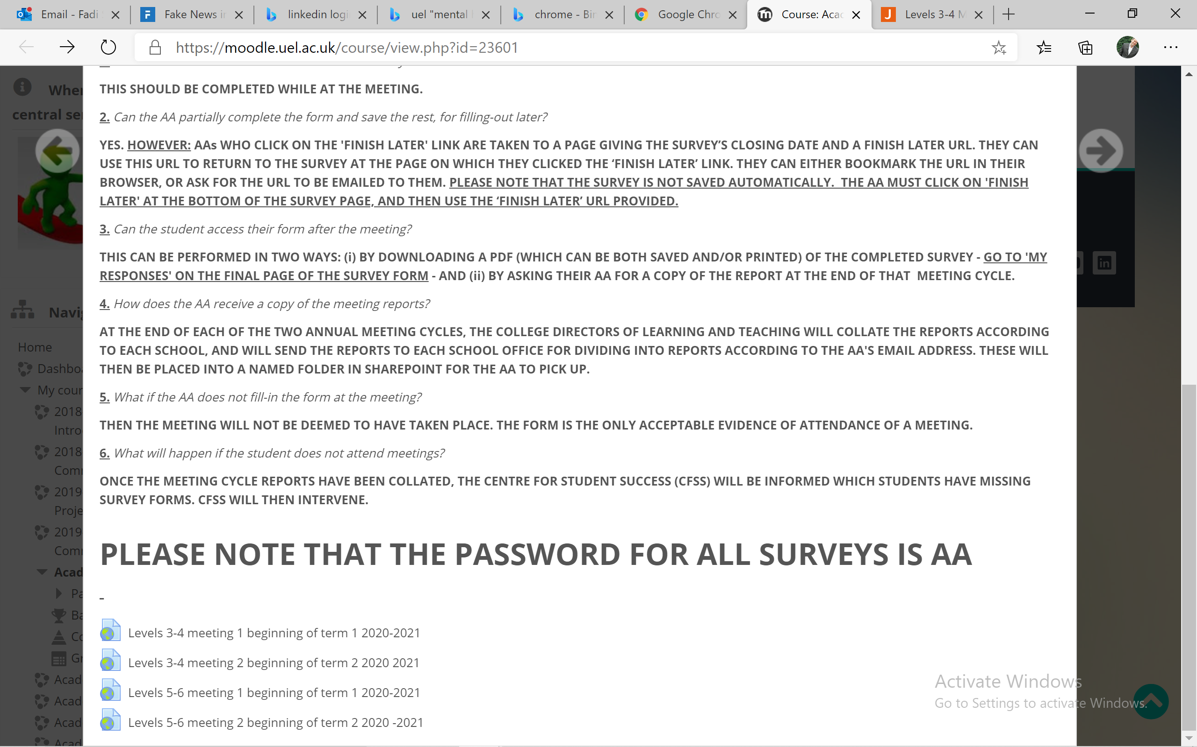
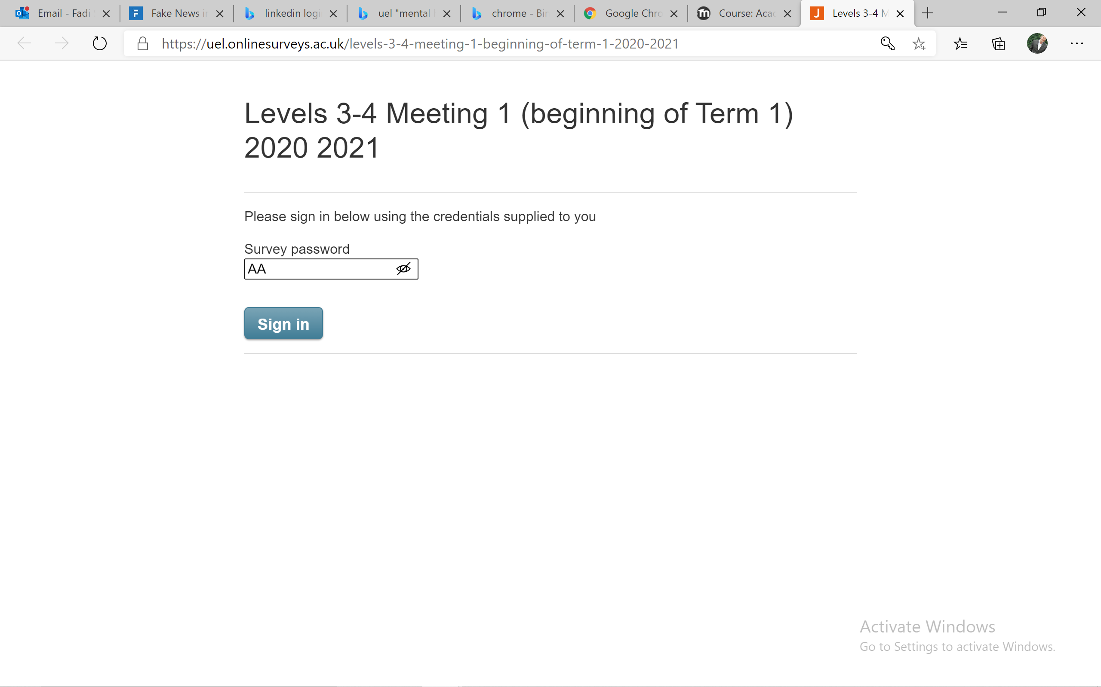
Contacting your Academic Advisor
Go To the following address:
https://moodle.uel.ac.uk/course/view.php?id=23601

Slide 26
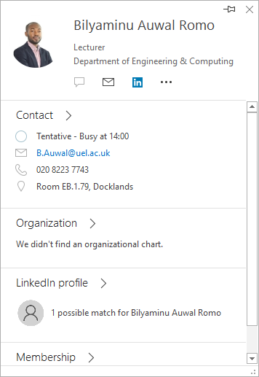
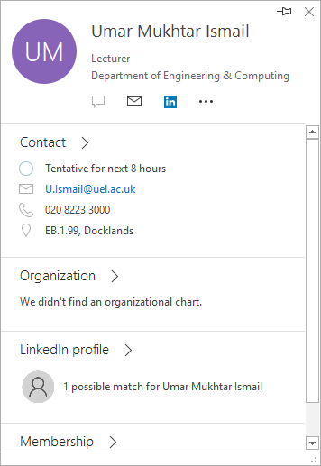
Contacting your Academic Advisor
Your Year Advisors are:
September Starters: Bilyaminu Auwal Romo
B.Auwal@uel.ac.uk
February Starters: Umar Mukhtar Ismail
U.Ismail@uel.ac.uk

Slide 27
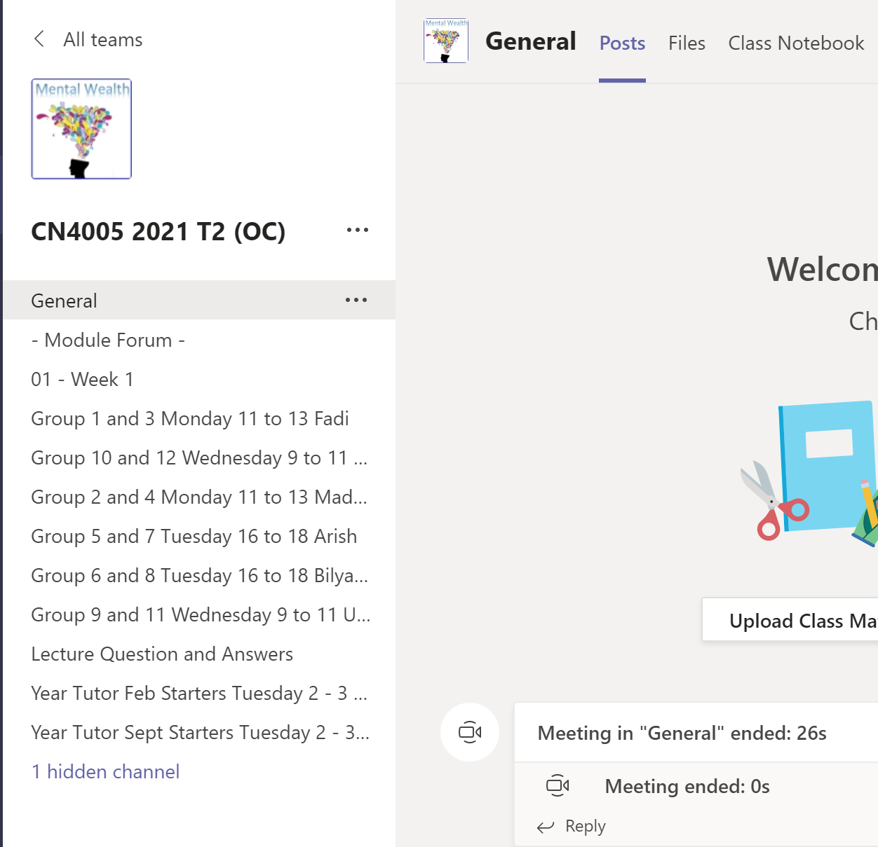
Contacting your Academic Advisors

Slide 28
End of part 3
Activity 1.3: Do the following:
Locate the folder for the task 1.
Open the Self Evaluation form and edit the first entry regarding your Java skills in programming.
Save a copy on your computer.
Tick the ‘activity’ completed box on the right hand side of the screen.

Slide 29
This week’s lesson:
Part 3
Self evaluation and CV writing:
What is self evaluation?
What is a CV?
What is included in a CV?
How to write a great CV.

Slide 30
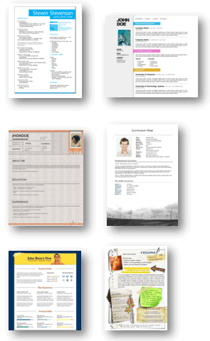
What is a CV?
Stands for: Curriculum Vitae
A CV is:
A Selling tool
An Outline of your Academic background, skills and Working experience
An opportunity to present yourself in the best possible light
A short and easy to read resume.
Without over selling yourself!

Slide 31
CV content: Should I have?
Work history
Age
Education
Skills
A photo
Political affiliation
Existing salary
Marital status
Number of children
Negative experience
Hobbies & interests
Weight, height, health
Disabilities
References

Slide 32
CV content: Should I have?
Provided you can do the job than none of these would ‘stop you’ from doing the job then you should NOT include these:
Age, Date of Birth, Place of birth
Ethnic identity
Disability
Political affiliation
Religious preference
Hobbies
Marital status
Sexual orientation
Photographs
Height, weight, health

Slide 33
Styles of CVs:
Skill Style:
Skills required by the job are given priority.
Chronological style:
Order of skills acquired are given priority using general headings.

Slide 34
Common Layout:
Personal Statement / Cover letter
Name and personal information
Objective
Work experience
Education
Personal characteristics
Interests
References

Slide 35
Personal Statement:
Example:
"A computing position where extensive designing, programming, testing and technical skills are required, preferably within Web design.
“Desire a position in the Business IT area. Prefer a position requiring responsibility and a variety of tasks”.

Slide 36

Mr. Martin Aitchison
123 Somestreet Road (020) 7474-0012
London, E16 2RD - UK martin.aitchison@hotmail.com
Desire a position in the Business IT area. Prefer a position requiring responsibility and a variety of tasks

Slide 37
Listing Academic and Working experience:
Usually you need to:
List them in reverse chronological order.
Highlight work experience key ones for the job.
Other skills key or related to the job.
You need to state: What, Where, and When.

Slide 38
Phrases to use:
Creative
Efficient
Proficient
Systematic
Hard worker
Enjoy working in groups and on my own.
Prefer to act...
Well versed in...
Willing to take initiative
Like to work in one place
Enjoy challenging experience...
Persistance to work underpressure
First-hand knowledge of...
Having a desire to learn
Quick learner

Slide 39
Useful work-related verbs:
Administered Analyzed Appraised
Assembled Budgeted Coached
Compiled Conducted Coordinated
Designed Developed Evaluated
Facilitated Managed Monitored
Negotiated Planned Repaired
Printed Recorded Recruited
Served Supervised Taught
Translated Wrote Reviewed

Slide 40

Other sections that you may have:
General Skills (not directly related)
Example: Driving license / languages..etc.
Volunteer work
Honors and Awards
Publications/presentations
Affiliations
Web links (samples of work!)

Slide 41
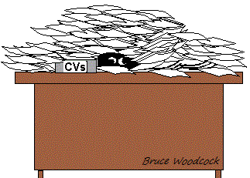
Put yourself in employers shoes:
Where scannable use bullet points
Use labels or keywords.
Less is more.
Make your presentation stand out.
Minimize use of abbreviations.

Slide 42
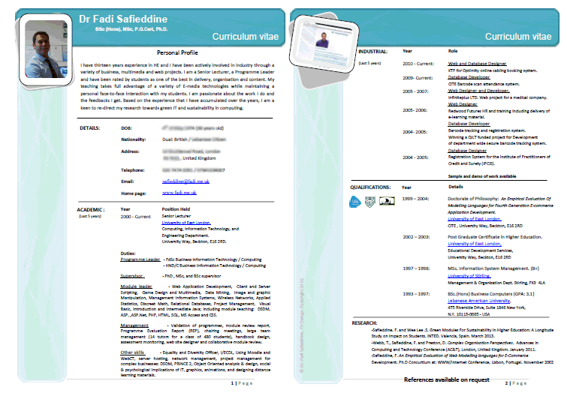
Show creativity in your presentation!

Slide 43
End of part 4
Activity 1.4. Look at four examples of CVs from last year (names and personal details covered).
And rank them from best to worse.

Slide 44
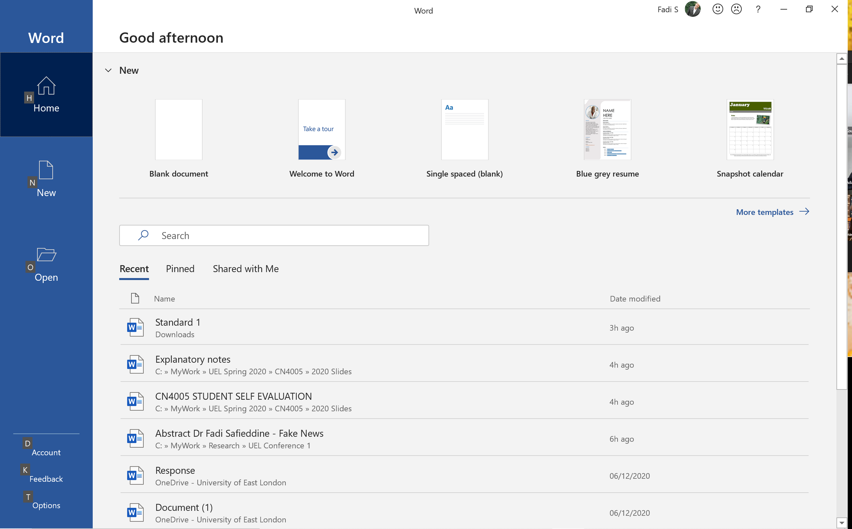
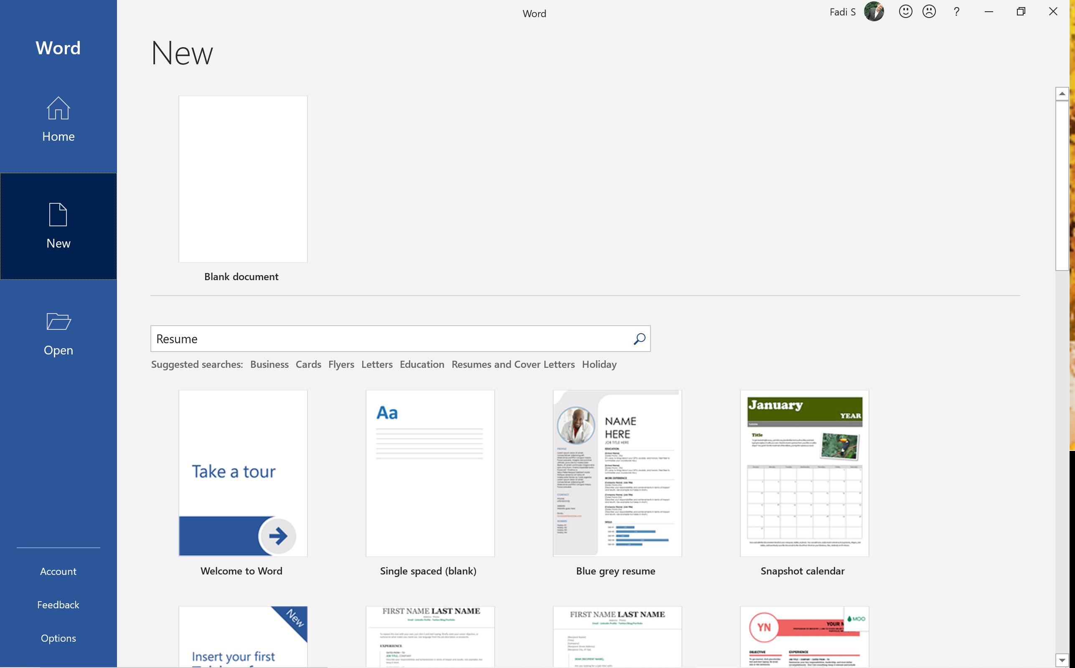
Lets have a demo: CV
Part 4

Slide 45
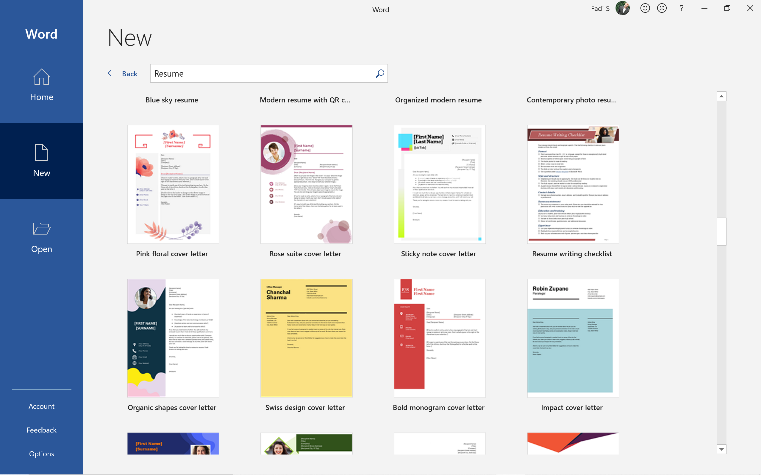
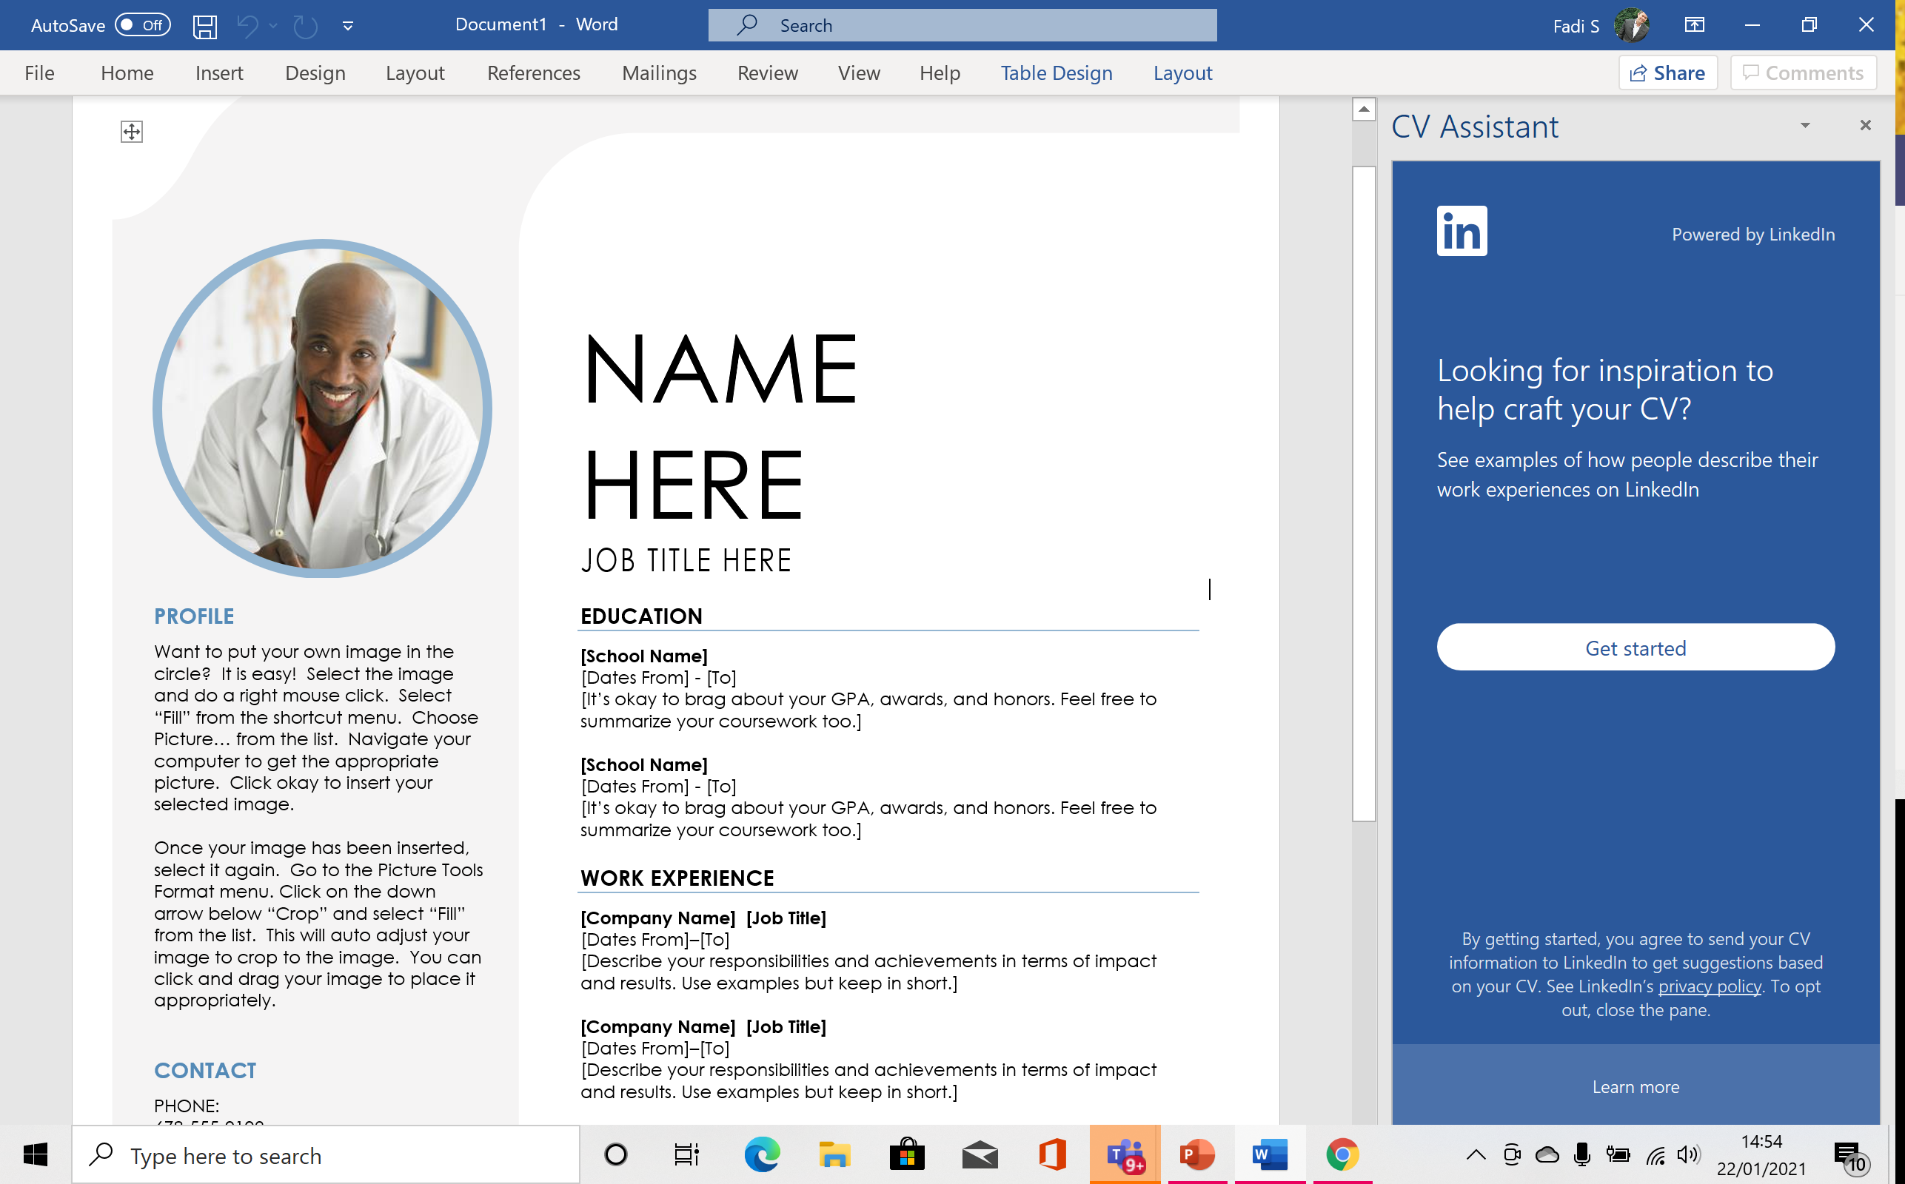
Lets have a demo: CV
Part 4

Slide 46
A job you really want?
Your CV needs to:
Match the Object you want
Show the Skills they want
Match required Job Skills
Show interest beyond being a ‘job’

Slide 47
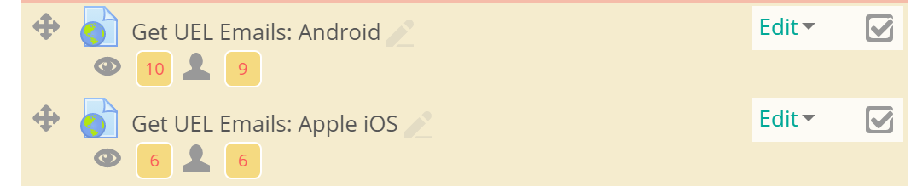
Set up UEL email on your phone

Slide 48
Things to do: Deadline next week
Complete the Self-evaluation online.
Complete the Mental Wealth Survey and email it to your Advisor.
Produce your first CV and show it to your tutor for feedback
Next week you submit the Self-evaluation and CV.
Set up your UEL email on your phone.

